Slide 1
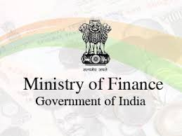
Finance Minister Budget Speech Analysis
Presented by – Group 3

Slide 2
Contents
Business Problem
Objective
Approach and methodology
Each finance minister’s speech comparison with the estimated data
Similarities between the speech’s
Common words spoken by each minister
Top 10 topics created using NMF
Sectors that need special attention
Features required to run the finance ministry
Conclusion

Slide 3
Business Problem
1) What was each minister’s financial focus? Was there a significant change in those sectors in the following year?
2) To find out to what extent a finance minister makes fake commitment in the speech?
3) To find similarities between the speeches from different ministers and hence find out persistent economical issues Ministry of Finance has been trying to solve in the last Decade?
4) Does the tone of the budget speech (Using information like Phrases used, sentiment, length, etc.) has a correlation with its possible outcome?
5) Score each finance minister based on their effectiveness?
6) To find the sectors that needs special attention but hasn’t been getting any?
7) From the speeches, list down features required for someone to run a Ministry of Finance effectively?

Slide 4
Objective
To analyze each finance minister’s speech
To find out similarities between the speeches
To find out sectors that need special attention
To find out the features to run the finance ministry

Slide 5
Approach & Methodology
Data reading and cleaning
Exploratory Data Analysis, Feature engineering and Data Visualization– Mine features, summarize the speeches, visualize etc.
Split the text into sentences and create data frames
Add sentiment for each sentence
Do a sector mapping
Understanding NMF
Create Topics
EDA using word clouds, bar charts

Slide 6
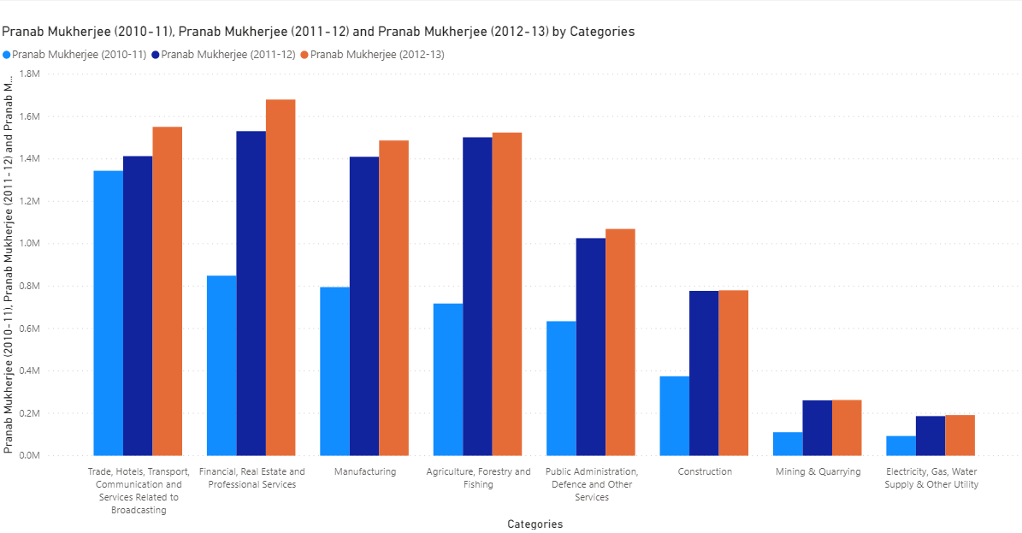
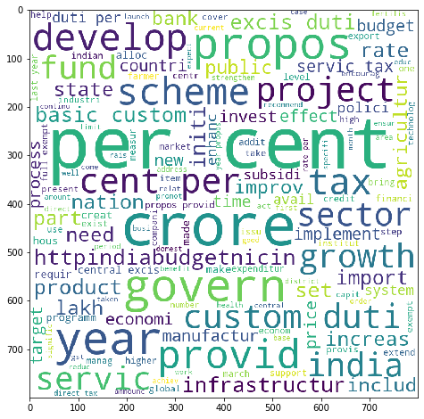
Finance minister: Pranab Mukherjee (2010-2013)
Comparison of PM’s speech with the estimated 2010-2013 data:
As the estimated data shows, most of the money was spent on trade and commerce, transport & communication.
FM focused on building the country’s infrastructure, “proposing” new tax schemes and overall growth and development of the country.
Mentioned about infrastructure, development plans but the estimated data was different. Less money was put into Constructions and basic necessities such as Electricity, Gas, Water Supply were completely ignored
Hence, many false promises were made.

Slide 7
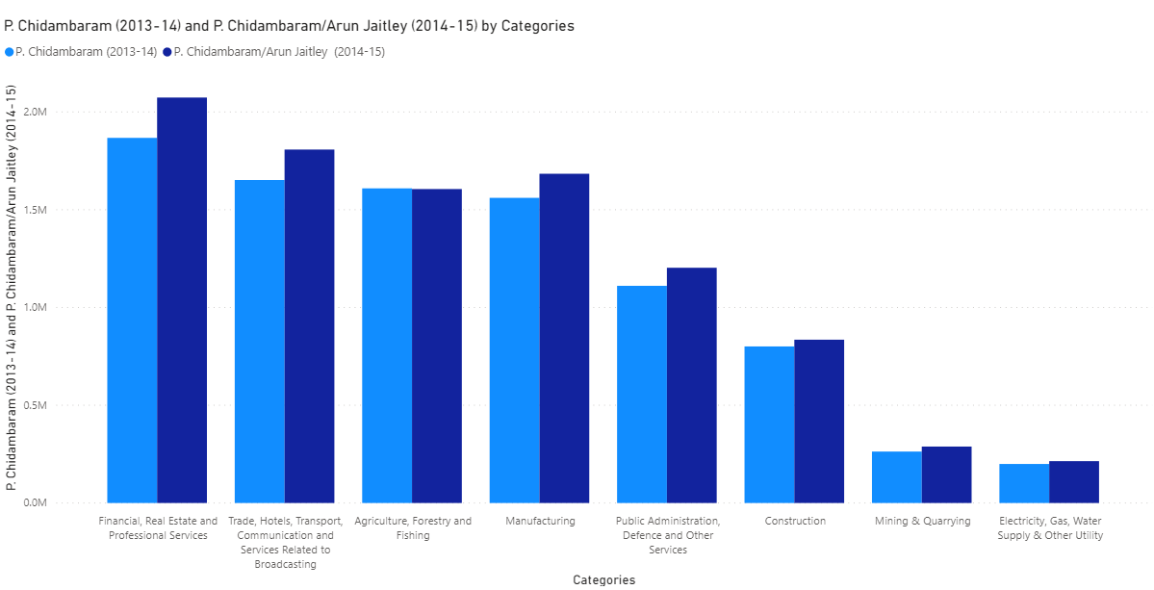
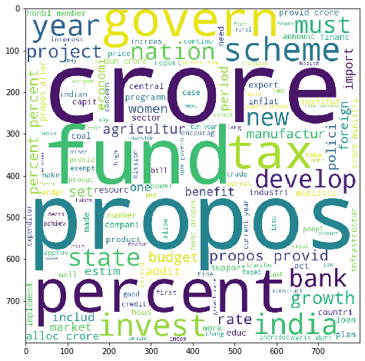
Finance minister: P. Chidambaram (2013-2014)
Comparison of PC’s speech with the estimated 2013-2014 data:
As the estimated data shows, huge amount of money was spent on Banking, Real Estate, Trade, Transport, Manufacturing and even on Agriculture.
FM promised to spend Crores of rupees on new tax schemes.
Major talking points were the Banking and Agricultural Sector. Proposed large Funds for the overall development of India.
Hence, it can be concluded that to some extent P. Chidambram did keep most of his promises.

Slide 8
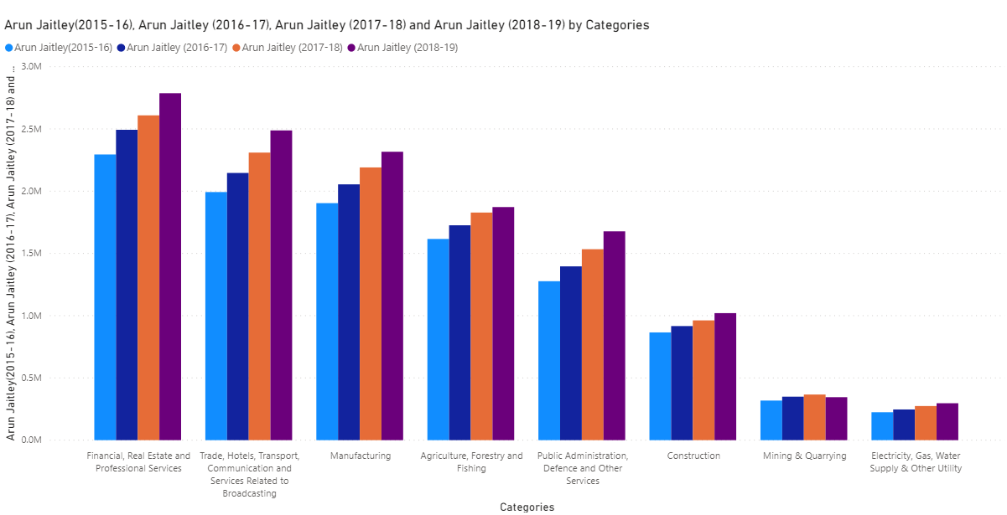
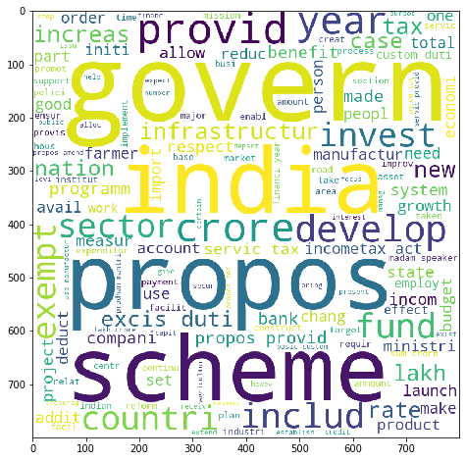
Finance minister: Arun Jaitley (2014-2019)
Comparison Arun Jaitley’s speech with the estimated data:
Each year, FM’s focus was on providing good governance. Mentioned about exempting people from different tax slabs.
Stressed on excise duty. Speech revolved around increasing Manufacturing in the country and major focus was on “Nation First”.
Estimated data shows that huge amount of money was spent on financial services, real estate and professional services which is in line with FM’s speech.
Mentioned about new tax schemes, building new infrastructure, new development plans for the country.
AJ also talked about farming and agriculture and which is in line with the spending in Agriculture, forestry and fishing sector.
Hence, Mr. Arun Jaitley did keep his promises.

Slide 9
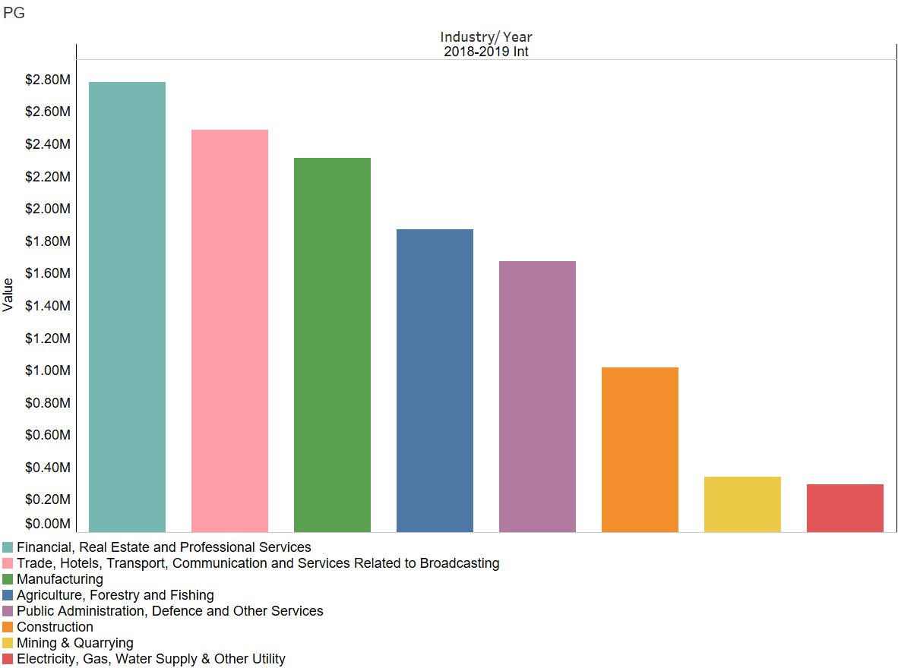
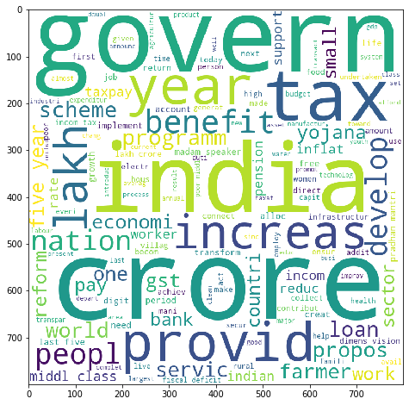
Finance minister: PIYUSH GOYAL (Jan 2020 – Feb 20)
Comparison of Piyush Goyal’s speech with the estimated data:
Estimated data shows that huge money was spent in 2018-2019 on public administration, defense, financial, real estate and other services. Piyush Goyal served two weeks in office and his focus was more on the tax benefits to the people, new schemes for farmers and other development plans.
Digital India, large-scale employment, energy security, electric vehicles were some of the highlights mentioned in the speech.
Government planned to provide 24X7 reliable electricity, the clean energy push, Ujjwal DISCOM Assurance Yojana (UDAY), to revive debt-ridden power distribution companies, to improving India’s energy access through the Deen Dayal Upadhyaya Gram Jyoti Yojana (DDUGJY).
Hence, promises were kept.

Slide 10
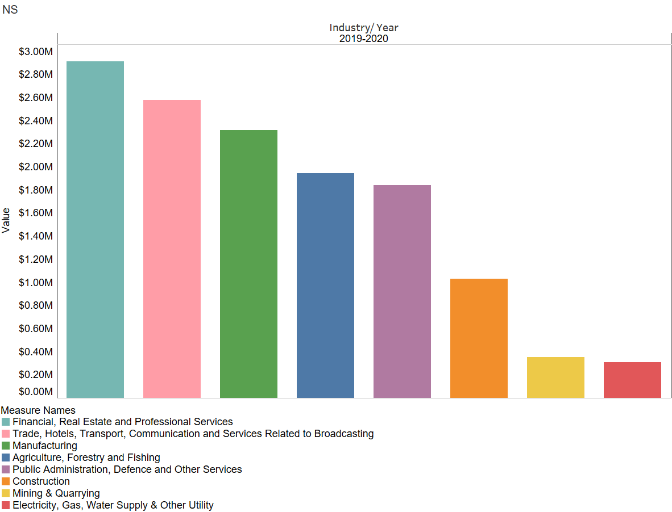
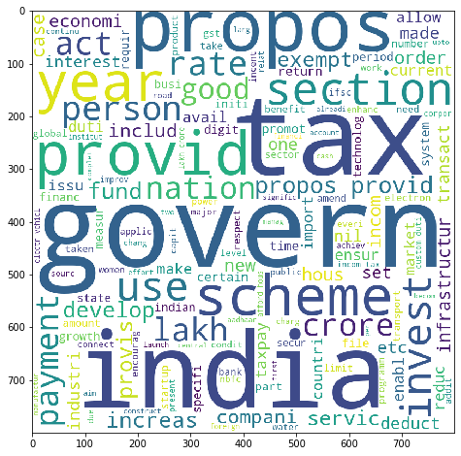
Finance minister: N. Sitharaman (2019 – Present)
Comparison of N. Sitharaman’s speech with the estimated data:
Estimated data shows that huge amount of money was financial, real estate sectors, trade, hotels, transport and communication.
Almost everything is in line with the most frequently used words in the word cloud. Government introduced new tax schemes.
Speech focused on higher education, and the ‘Khelo India’ programme.
Proposed new digital India schemes. Estimated data shows that the government was focused on the development of the country and delivered what they promised.
This speech also has similarities with Arun Jaitley’s speech.

Slide 11
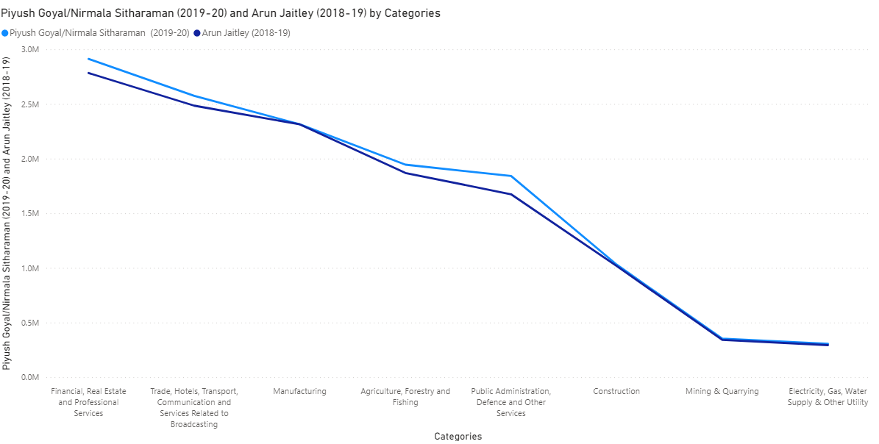
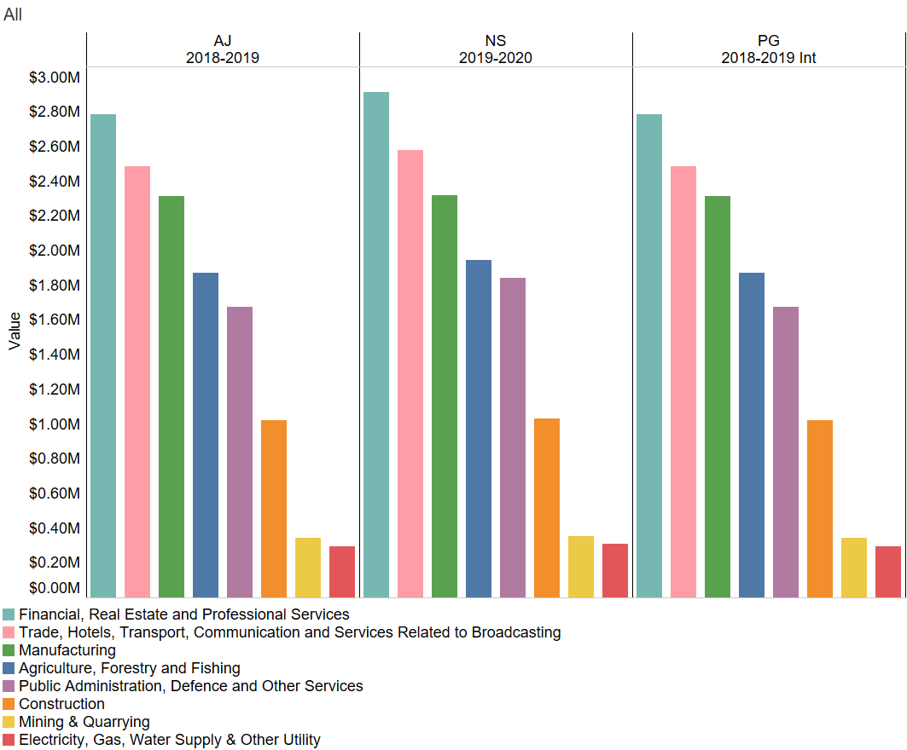
Similarities between AJ’s, NS’s & PG’s speech
We can see that Arun Jaitley, Piyush Goyal and N. Sitharaman spent more on the financial, real estate and professional services.
This government also worked on transport and communication where they launched many new projects.
Planned to provide new infrastructure for the country.
Planned new tax schemes which would benefit middle class of the country.
Launched new agricultural reforms for the farmers.

Slide 12
EDA, common words spoken by different ministers
The common words are:
Govern
Schemes
Tax
Development
Funds
Growth
This implies that:
Every minister focused on good governance
They also launched new schemes in different sectors
Primary focus was to improve the tax slabs for middle class and launch new schemes
Concerned about the growth & development of the country
Allocated huge amount of funds every year for different projects

Slide 13
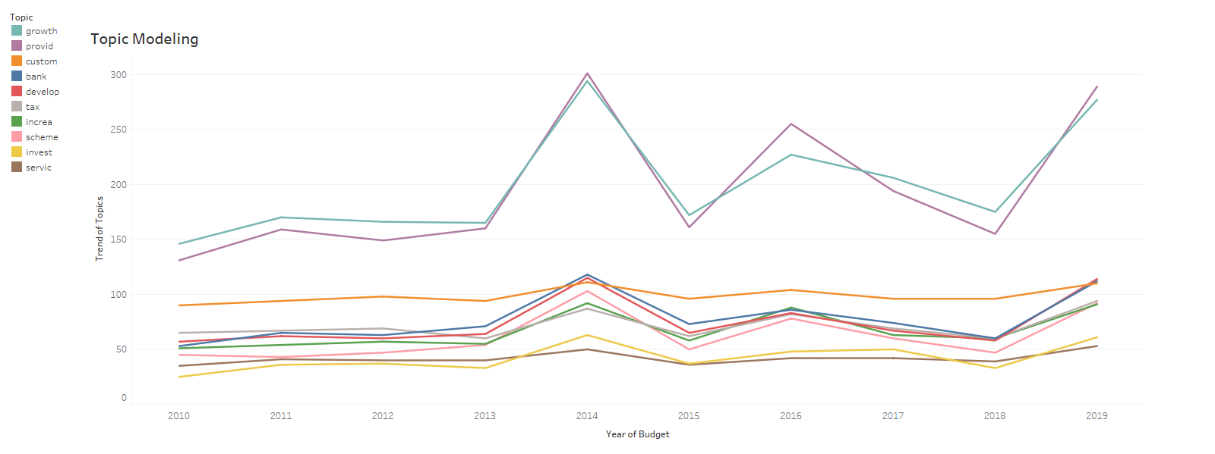
Top 10 topics created using NMF
All top 10 topics derived from NMF had fluctuating trend and most of them had a peak in 2014
Every minister focused on growth of the country (Growth in terms of economy, GDP, agriculture sector)
‘Custom’ topic had a constant trend and ‘invest’ topic which includes bond, investors, fund, infrastructure was at the last

Slide 14
Sectors that need special attention but haven’t been given
Basic necessities like Electricity and Water Supply.
Major Constructions such as roads, flyovers, hospitals, etc.
Sectors such as Defense which should be given utmost priority have been given relatively lesser funds.

Slide 15
Features required by someone to run the Ministry of Finance effectively
Strong agenda-setting power.
Strong monitoring power.
Excellent communicator.
Strong Vision: They must always have one eye on the future.
Results Driven: Finance Ministers should be apt at both setting targets and meeting them.
Numerate: They must be comfortable with numbers and be able to leverage important insights from them.

Slide 16
Conclusion
Each finance minister’s initial focus was on improving banking, real estate and professional services.
However, some of them spent more on the manufacturing than agricultural and forest sectors.
Some of the finance ministers made fake commitments as they talked about building country’s infrastructure but the estimated data showed different trends.
Yes, there were similarities between the speeches of Arun Jaitley, Piyush Goyal and N. Sitharaman.
Yes, the sentiment attached with each sentence of the speech had some impact on the final outcome of the speech.
Sectors that needs special attention – Refer slide 12
Features required for someone to run a finance ministry effectively – Refer slide 13

Slide 17
THANK YOU

